Slide 1
Predicting Best Picture Nominees and Winners
A Preliminary Analysis
10/9/2015

Slide 2
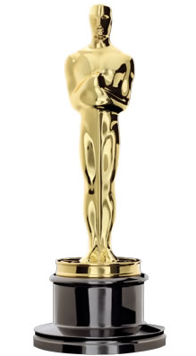
A Best Picture nomination or win is very prestigious and can substantially increase box office revenue
About the
Academy Awards
The Academy Awards or The Oscars are an annual American awards ceremony honoring cinematic achievements in the film industry
Awards are given in various categories, with perhaps the most prestigious being the award for Best Picture
Why They Matter
The Oscars are generally regarded as the most prestigious awards in film
Additionally the nominations and awards provide tremendous exposure
A Best Picture nomination alone has been estimated to increase box office revenue by ~$6.9 million*

Slide 3
Unfortunately, there is no “magic formula” for predicting Best Picture success
Best Picture Prediction Model
The Good
My best model is 98% accurate at predicting Best Picture winner / nominee status
The Bad
BUT… does so by saying no movies are ever nominated (much less picking a winner) yielding a 0% true positive rate
The Ugly
“Forcing” the model to make predictions leads to strong overfitting, and simply increases the number of false positives without any increase in true positives
There is simply too much variability movie to movie to accurately, and consistently predict Best Picture nominations with a single model

Slide 4
There are however some factors that do improve a movie’s chances
Factors that are Good Predictors of Best Picture Success
Strongest
Director(s)
Actors / Actresses
Writer(s)
Genre
Country
Language
Critical Opinion
Public Opinion
Number of nominees in year
Month of release
Decent
Gatekeepers
Marginal

Slide 5
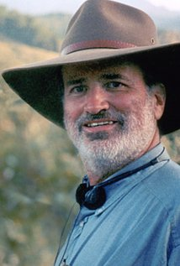
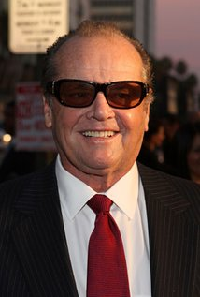
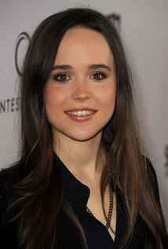
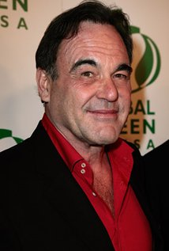
People matter!
People that Most Contribute to the Likelihood of Best Picture Success
Directors
Actors
Actresses
Writers
Terrence Malick
Frank Darabont
Peter Jackson
Martin Scorsese
…
Worst:
Tim Burton
Jack Nicholson
Tom Hanks
Russell Crowe
Daniel Day-Lewis
…
Worst:
Philip Seymour Hoffman
Ellen Page
Jodie Foster
Mila Kunis
Amy Adams
Sandra Bullock
Keira Knightley
…
Oliver Stone
James Cameron
Jason Reitman
Ben Affleck
Spike Jonze
M. Night Shyamalan

Slide 6
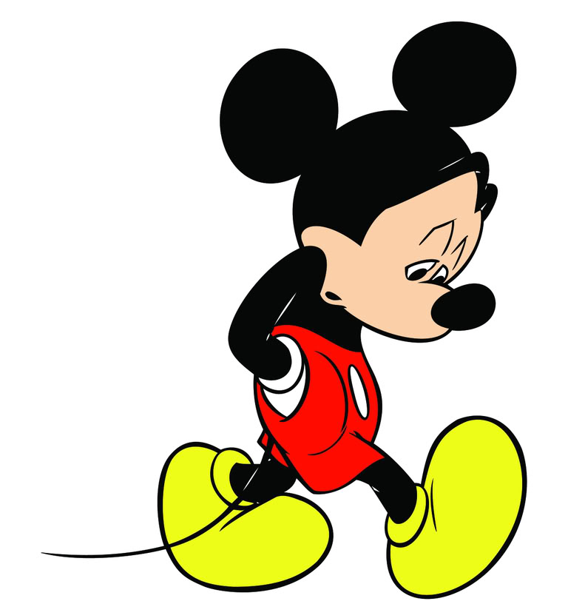

Not all genres are created equal
Best Genres for Success
Worst Genres for Success
Western
Biography
War
Romance
Animated
There is a clear bias towards more adult and historical topics

Slide 7

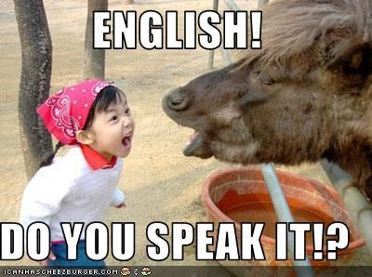
Don’t be foreign
Country of Origin
Language
Despite their overwhelming number each US movie gets a bump just for being American
Similarly, English language movies also get a bump just for being in English

Slide 8
The opinion of critics and the public matter, but not as much as might be thought
Ratings by Critics and the General Public
Even for the very best movies, critic and public ratings provide relatively little positive boost
They act more as a “gatekeeper” and punish movies below a certain threshold (~7/10)
Illustration*
Relatively little boost even at high values
Nomination More Likely
0 rating
10
Nomination Less Likely
Poorly rated movies punished

Slide 9
There are still areas for additional exploration that could yield further insight and improve prediction power
Data
Methodologies
More directors, actors, actresses, writers, etc.?
Composers?
Cinematographers?
Reach (# of screens)?
Data on other award nominations / wins?
More historical data?
Etc.
Logistic regression?
Classification?
Regression / classifications trees?
KNN?
Bayesian probability based approach?
Etc.

Slide 10
Questions?
?

